Slide 1
Systems Security
Topic 2B

Slide 2
Learning Outcomes
By the end of this lesson, you should be able to:
1. Describe different threat intelligence sources
2. Describe multiple ways to secure a system

Slide 3
Threat Intelligence Sources
Organizations are now pooling resources and knowledge about the latest attacks with the broader security community
One type of shared information is the evidence of an attack
Key risk indicators (KRIs) are metrics of the upper and lower bounds of specific indicators of normal network activity
These indicators may include the total network logs per second, number of failed remote logins, network bandwidth, and outbound email traffic
A KRI exceeding its normal bounds could be an indicator of compromise (IOC)
An IOC shows that a malicious activity is occurring but is still in the early stages of an attack
IOC information aids others in their predictive analysis or discovering an attack before it occurs

Slide 4
Threat Intelligence Sources
Two categories of threat intelligence sources are open source and closed source
Open Source Information
“open source” refers to anything that could be freely used without restrictions
Open source threat intelligence information is often called open source intelligence (OSINT)
Closed Source Information
Closed source is proprietary
Organizations that are participants in closed source information are part of private information sharing centers that restrict both access to data and participation
All candidates must go through a vetting process and meet certain criteria

Slide 5
Categories of Sources
Two concerns around public information sharing centers are:
Privacy – an organization that is the victim of an attack must be careful not to share proprietary or sensitive information when providing IOCs and attack details
Speed – Automated Indicator Sharing (AIS) enables the exchange of cyberthreat indicators between parties through computer-to-computer communication
Two tools facilitate AIS:
Structured Threat Information Expression (STIX) is a language and format used to exchange cyberthreat intelligence
Trusted Automated Exchange of Intelligence Information (TAXII) is an application protocol for exchanging cyberthreat intelligence over HTTPS

Slide 6
Sources of Threat Intelligence
Sources of threat intelligence that are useful:
Vulnerability database is a repository of known vulnerabilities and information as to how they have been exploited
https://vuldb.com/
https://security.snyk.io/
https://cve.mitre.org/
https://www.exploit-db.com/
https://nvd.nist.gov/vuln/search
File and code repositories where victims of an attack can upload malicious files and software code that can be examined by others to learn more about the attacks and craft their defenses
https://attack.mitre.org/
https://virustotal.com/
https://attack.mitre.org/

Slide 7
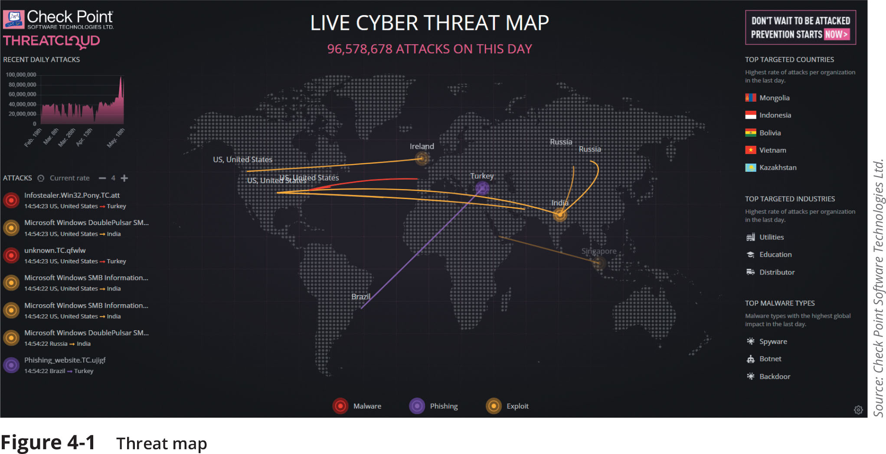
Sources of Threat Intelligence
Threat maps illustrate cyberthreats overlaid on a diagrammatic representation of a geographical area
https://threatmap.checkpoint.com/

Slide 8
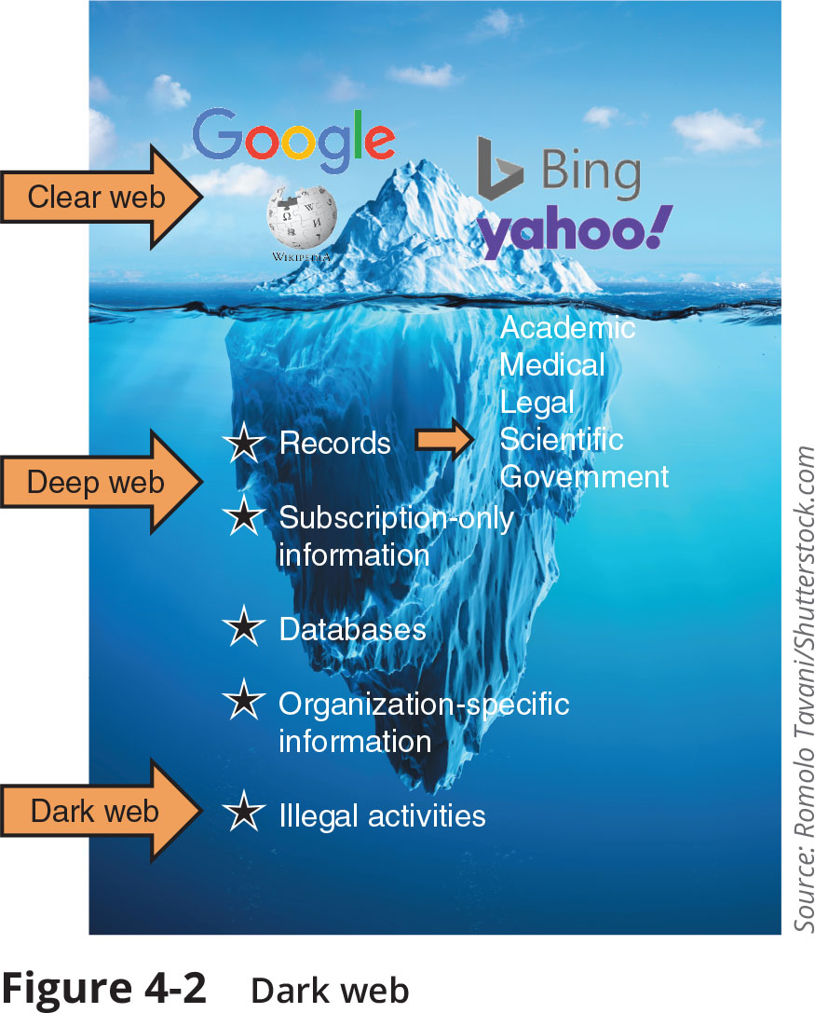
Sources of Threat Intelligence
Dark web – security professionals and organizations use the dark web on a limited basis to look for signs that information critical to that enterprise is being sought out or sold on the dark web
https://sci-hub.se/
https://ahmia.fi/
https://darknetone.com/market/dread/
https://keybase.io/
https://riseup.net/

Slide 9
Securing Endpoint Computers
Securing endpoint computers primarily involves three major tasks:
Confirming that the computer has started securely
Protecting the computer from attacks
Hardening it for even greater protection

Slide 10
Confirm Boot Integrity
Ensuring secure startup involves the Unified Extensible Firmware Interface (UEFI) and its boot security features
Unified Extensible Firmware Interface (UEFI)
Early booting processes used firmware called the BIOS (Basic Input/Output System)
To add functionality, an improved firmware interface was developed to replace BIOS
UEFI includes:
The ability to access hard drives that are larger than 2TB
Support for an unlimited number of primary hard drive partitions
Faster booting
Support for networking functionality in the UEFI firmware itself to aid in troubleshooting

Slide 11
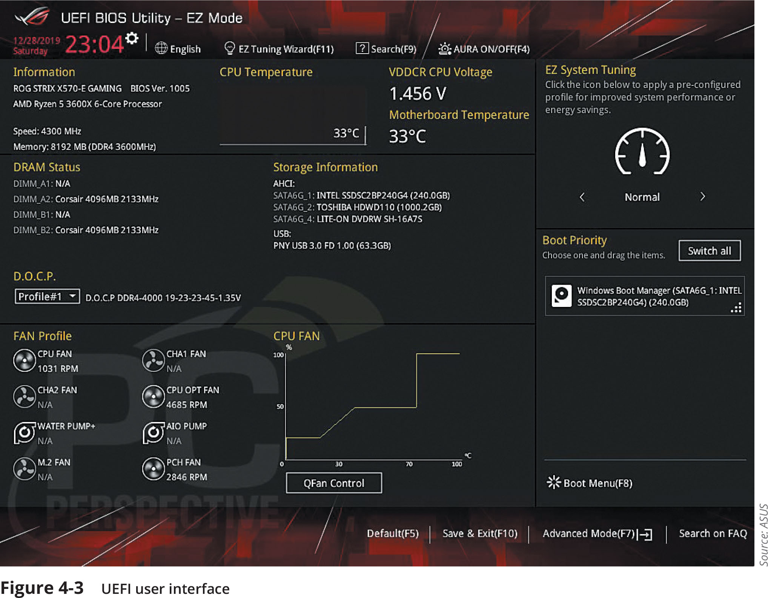
Confirm Boot Integrity

Slide 12
Confirm Boot Integrity
Boot Security
The ability to update the BIOS in firmware opened the door for a threat actor to create malware to infect the BIOS (called a BIOS attack)
Boot security involves validating that each element used in each step of the boot process has not been modified
This process begins with validation of the boot software, then it can validate the software drivers, and so on until control has been handed over to the OS
Called chain of trust because each element relies on the confirmation of the previous element to know that the entire process is secure
The strongest starting point is hardware, which cannot be modified like software (known as hardware root of trust)

Slide 13
Protect Endpoints
Protection on computer endpoints can be accomplished through software installed on the endpoint, such as:
Antivirus software, antimalware, web browser protections, and monitoring and response systems
Antivirus
Antivirus (AV) software can examine a computer for file-based virus infections and monitor computer activity (such as scanning new documents that might contain a virus)
Log files created by AV products can provide beneficial info regarding attacks
Many AV products use signature-based monitoring, called static analysis
A newer approach to AV is heuristic monitoring, called dynamic analysis

Slide 14
Protect Endpoints
Antimalware
Antimalware is a suite of software intended to provide protections against multiple types of malware
Antimalware spam protection is often performed using a technique called Bayesian filtering
Filters by analyzing every word in each email and determines how frequently a word occurs in a spam pile versus a nonspam pile
Another component of an antimalware suite is antispyware, which helps prevent computers from becoming infected by spyware
Uses pop-up blockers, which allow the user to select the level of blocking, ranging from blocking all pop-ups to allowing specific pop-ups

Slide 15
Protect Endpoints
Web Browsers
Web browsers offer the following security on endpoint computers:
Secure cookies are sent to a web server with an encrypted request over the secure HTTPS protocol
This prevents an unauthorized person from intercepting a cookie that is being transmitted between the browser and the web server
HTTP Response Header are headers that tell the browser how to behave while communicating with the website

Slide 16
Protect Endpoints
Monitoring and Response Systems
There are three types of monitoring and response systems for endpoint computers:
Host Intrusion Detection Systems (HIDS) is a software-based application that runs on an endpoint computer and can detect an attack has occurred
Host Intrusion Prevention Systems (HIPS) monitor endpoint activity to immediately block a malicious attack by following specific rules
Endpoint Detection and Response (EDR) tools are considered more robust than HIDS and HIPS
An EDR can aggregate data from multiple endpoint computers to a centralized database
EDR tools can perform more sophisticated analytics that identify patterns and detect anomalies

Slide 17
Harden Endpoints
Hardening endpoints involves patch management and OS protections
Patch Management
Effective patch management involves two types of patch management tools to administer patches
Patch distribution using an automated patch update service
Patch reception in Microsoft Windows 10 includes the following options:
Forced updates
No selective updates
More efficient distribution

Slide 18
Harden Endpoints
Operating Systems
Securing an OS involves proper security configurations and using confinement tools
A typical OS security configuration should include the following:
Disabling unnecessary ports and services
Disabling default accounts/passwords
Employing least functionality
In Microsoft Windows, a security template is a collection of security configuration settings that can be used to deploy security settings to multiple computers
Windows 10 Tamper Protection security feature prevents Windows security settings from being changed or disabled by a threat actor who modifies the registry
A Group Policy setting can also prevent access to registry editing tools

Slide 19
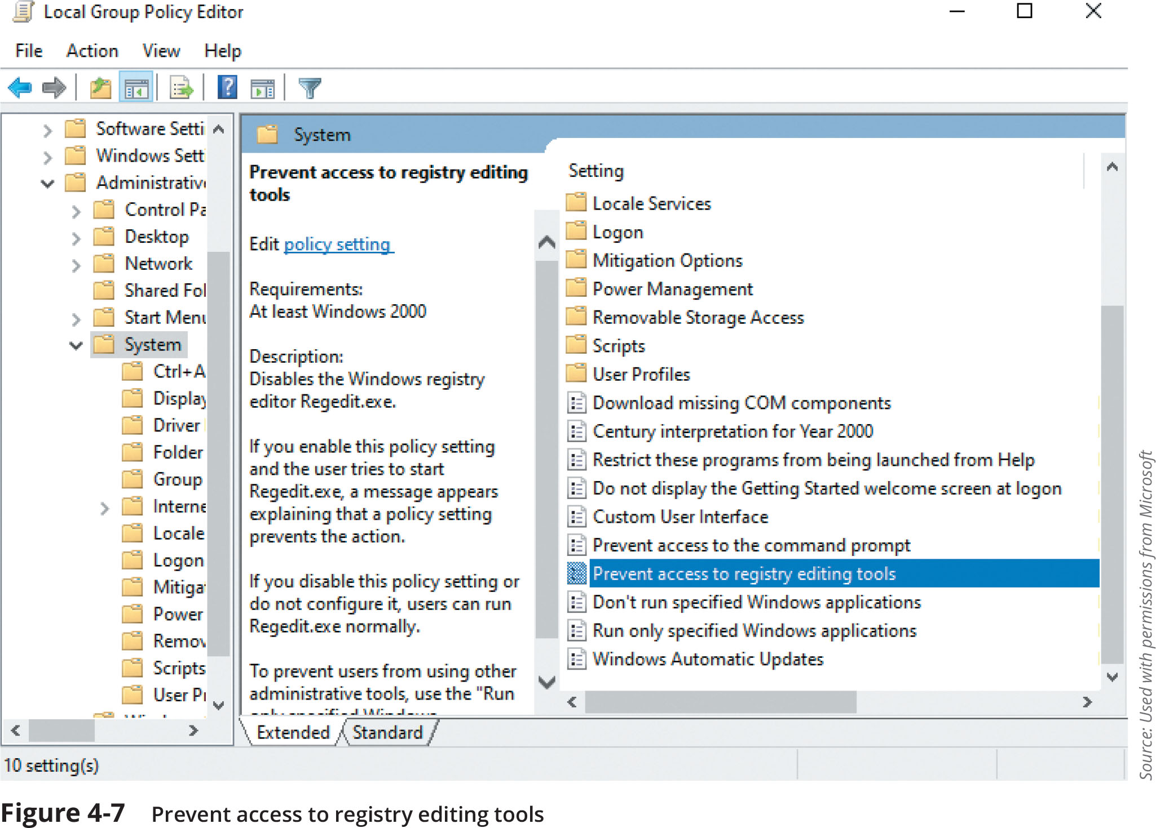
Harden Endpoints

Slide 20
Harden Endpoints
Operating Systems (continued)
Confinement Tools – several tools can be used to restrict malware:
Application whitelisting/blacklisting
Sandbox
Quarantine

Slide 21
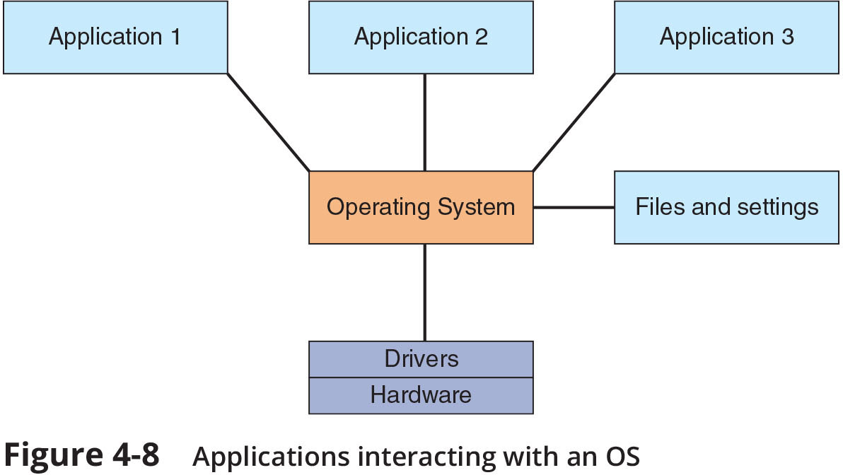
Harden Endpoints

Slide 22
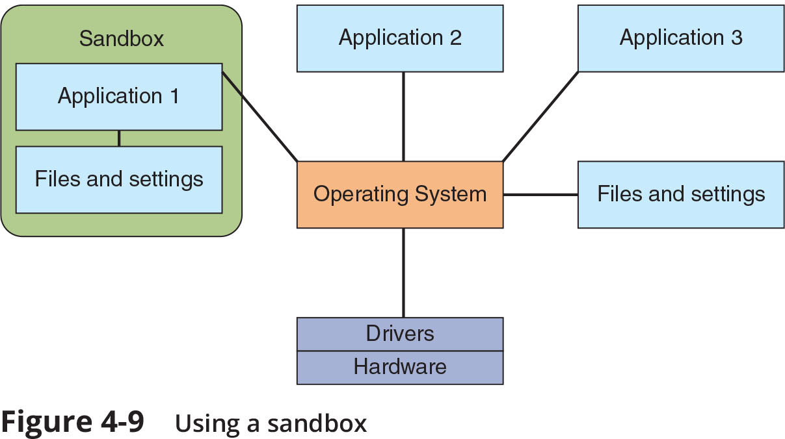
Harden Endpoints

Slide 23
Summary
Organizations are pooling their experiences and knowledge gained about the latest attacks with the broader security community because sharing this type of information has become an important aid to help other organizations shore up their defenses
Several sources of threat intelligence are useful: a vulnerability database, a cybersecurity threat map, and file and code repositories are examples
One of the steps that is often overlooked in securing endpoint computers is to confirm that the computer has started without any malicious activity taking place
Antivirus (AV) software can examine a computer for any file-based virus infections and monitor computer activity and scan new documents that might contain a virus
Web browsers have a degree of security that can protect endpoint computers
One of the most important steps in securing an endpoint computer is to promptly install patches

